Slide 1

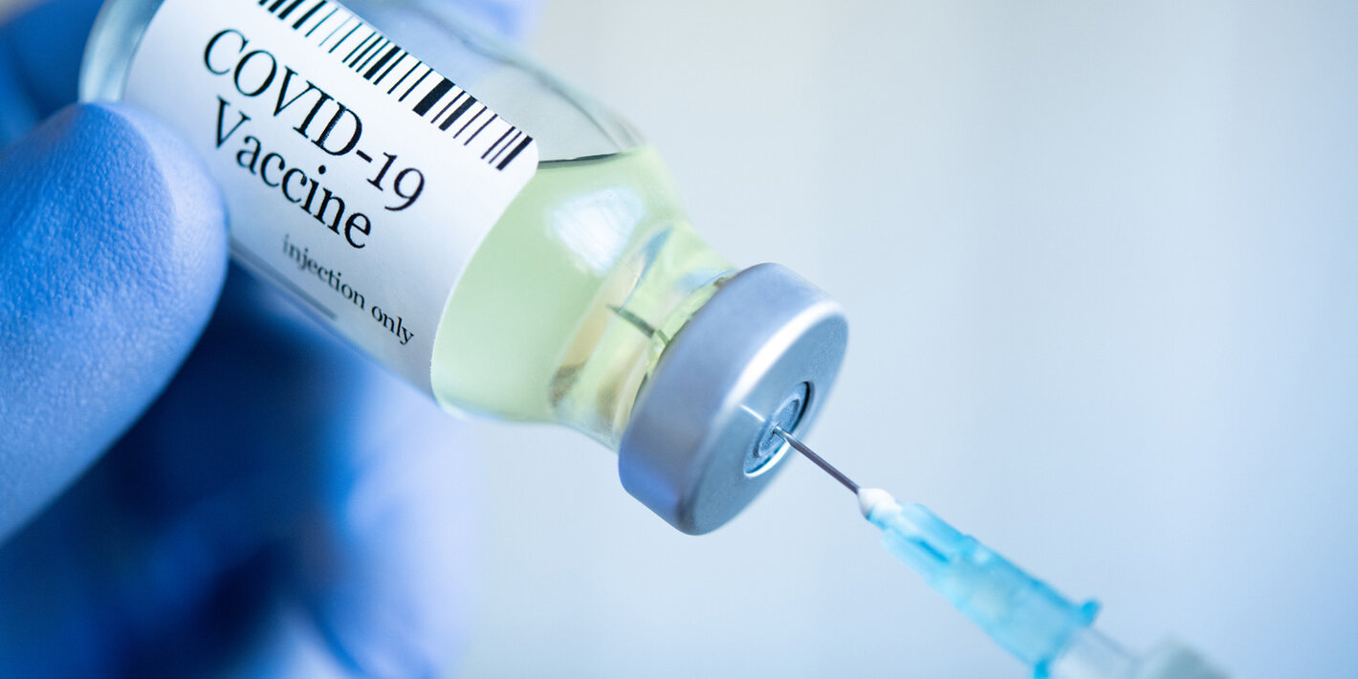


COVID-19 Vaccine Sentiment
Khushboo Dodani
Yelin Fan
Xinyuan Wang
Muhammad Ali
Depeng Ye
Notes:
“Countries in the Americas notified of first COVID-19 vaccine allocations through COVAX.” by Daniel Epstein, Nancy Nusser. Source:
https://www.paho.org/en/news/31-1-2021-countries-americas-notified-first-covid-19-vaccine-allocations-through-covax

Slide 2
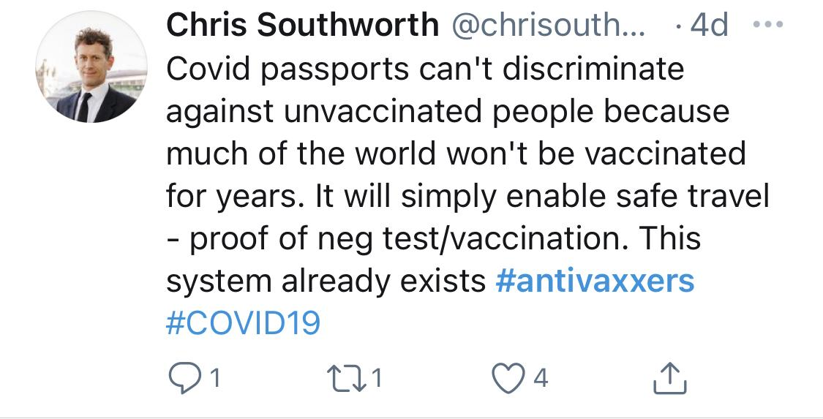
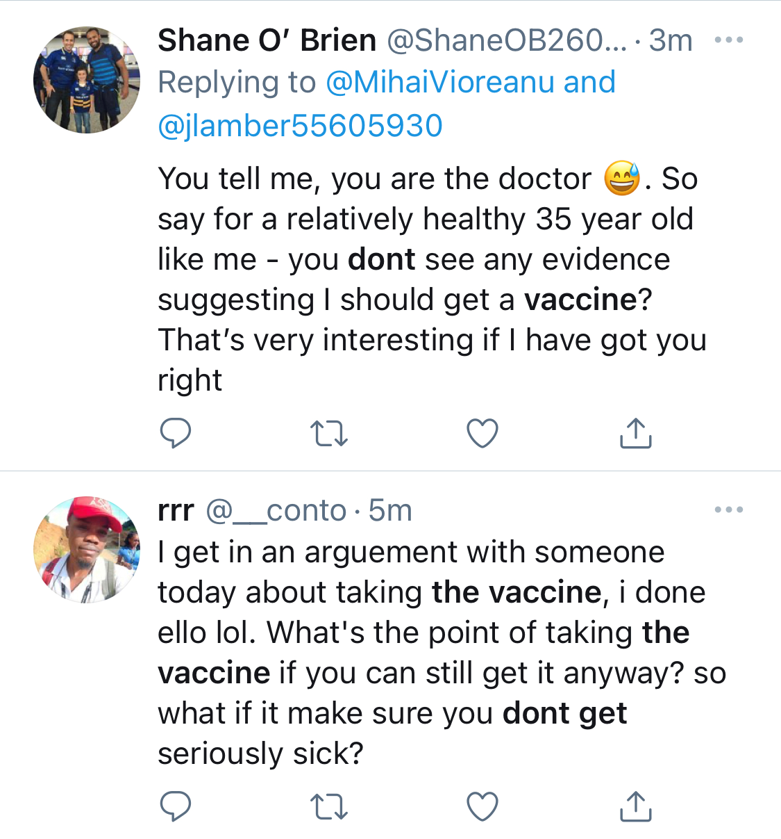
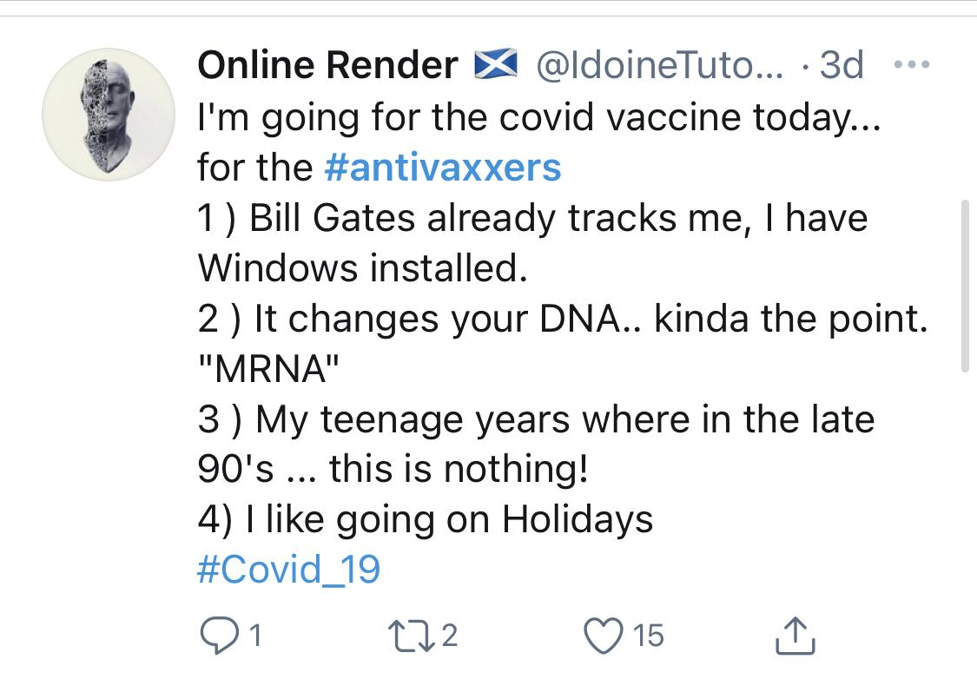

Background
The discovery of a vaccine is a benchmark of the battle against virus.
The next challenge for pharma companies and governments is how to convince people to accept a vaccination and improve the proportion of people vaccinated.
Hesitancy and worry of taking vaccines can be widely found on social medias, like Twitter and Facebook.
Problem Statement
Can the rate of vaccine adoption be increased?
What is the ‘people vaccinated’ percentage in different continents?
What are major concerns people generally have with respect to the vaccines?
For reluctant people, what are their major concerns regarding the vaccines?
Notes:
The good news of efficacy of available COVID-19 vaccines are cheerful and now there are more than 148 countries providing vaccines to their residents.(https://ourworldindata.org/covid-vaccinations) However, the ideal estimation of getting all countries fully covered will be until early 2023 (https://www.bbc.com/news/world-56025355). It seems now the big challenge in front of pharma companies and governments is how convince people to accept the vaccine. To tackle this problem, we firstly need run an analysis about what drives people’s hesitancy against getting vaccinated most and then make our suggestion and recommendation to remove these concerns.
COVID was declared a pandemic in March 2020 and people globally looked forward to science that could offer preventive measures or treatment. Still, in a pre-vaccine survey about 64% of adults in the United States of America expressed reluctance intake a vaccine if one was available. Fast forward to January 2021, major players in the pharmaceutical industry have developed vaccines with the following efficacy:
Pfizer/BioNTech: 95%
Moderna: 95%
AstraZeneca 70%
Johnson & Johnson: 66%
And yet, 47% of Americans are still hesitant to take a vaccine.
The purpose of this study is twofold:
To understand public sentiment regarding the COVID-19 vaccination in hopes to identify major factors that cause reluctance in communities.
Some studies and patient interviews also suggest that people are expressing hesitancy in taking the second dose of the mostly required 2-dose vaccination process. This study will aim to identify concerns people have with respect to the vaccination process and other logistic aspects (for example: role of the government).
Twitter sources:
https://twitter.com/shaneob26008190/status/1373022058574151684?s=21
https://twitter.com/__conto/status/1373021538555990021?s=21
https://twitter.com/chrisouthworth/status/1371413745159839750?s=21
https://twitter.com/idoinetutorials/status/1371718558179336192?s=21

Slide 3
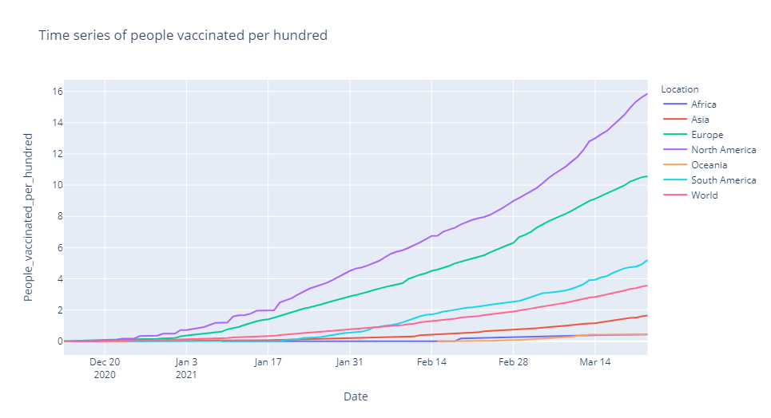
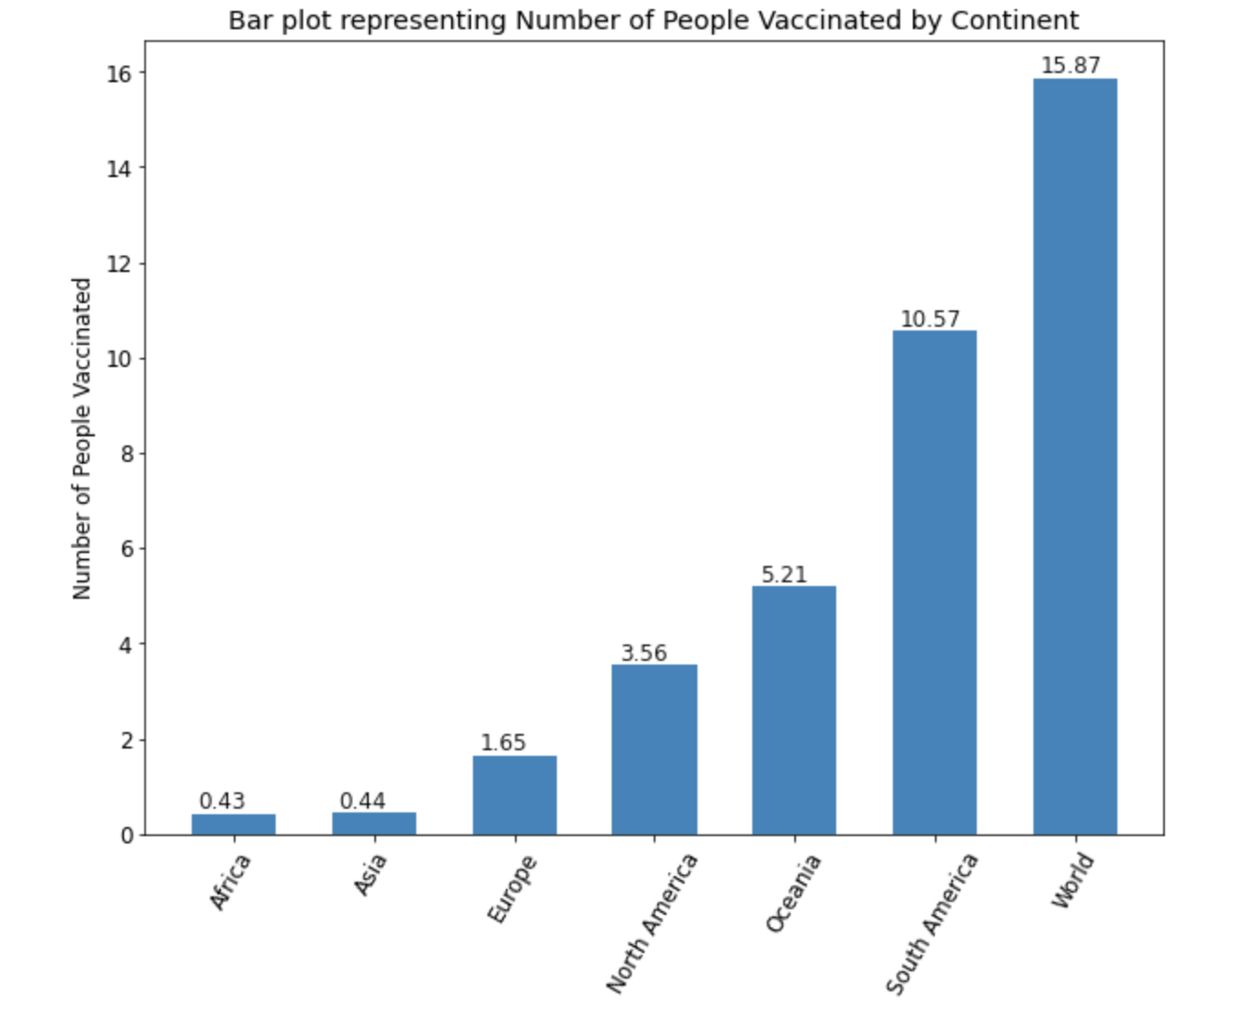
Demographic Results
Our study aims to analyze vaccine hesitancy and adoption behaviours
While some continents have been slow at vaccine adoption, others have comparatively high vaccination rates (e.g. North America vs Asia).
Slow adoption could be a result of general public reluctance due to a variety of reasons, such as inadequate knowledge, lack of trust, fear
Notes:
Analysis:
As the time-series plot will indicate, Africa has the least number of people vaccinated from the countries that we were able to analyze given our dataset. This can be attributed to different factors such as lack of access to COVID- testing and treatment equipment, few numbers of overall cases or hesitancy in the general public to take the vaccine. North America on the other hand, until March 14th, has the highest number of people vaccinated given our dataset. As seen, the rate of people being vaccinated starts to increase around January 17th and then increases at a much quicker rate.
Our study aims to analyze this trend through vaccine hesitancy and adoption behaviours.

Slide 4
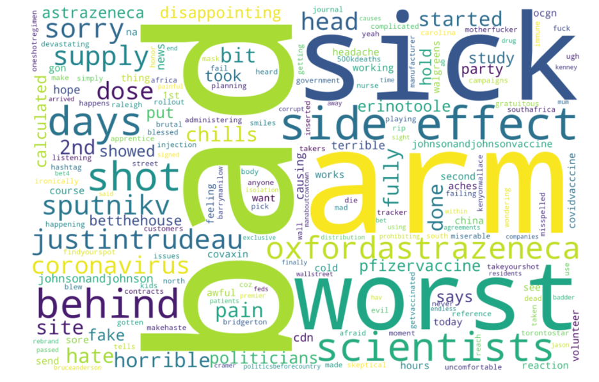
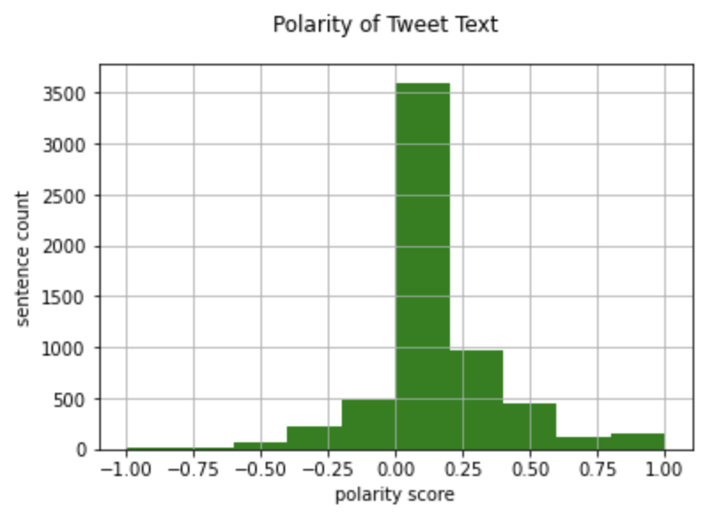
Keywords Results
Sentiment & Keywords
The majority of analyzed tweets present a slight positive attitude (polarity 0-0.25) towards COVID-19 vaccines.
Concerns summarized from top words mentioned in ‘negative’ tweets:
Safety and Efficacy ( ‘side effect’’, ‘headache’, ‘uncomfortable’, ‘sick’, ‘aches’, ‘pain’, ‘fail’)
Political concerns (‘government’’, ‘politicsbeforecountry’, ‘corrupt’)
Confusion of vaccine administering (‘shot’, ‘supply’, ‘distribution’’)
Our study aims to analyze vaccine hesitancy and adoption behaviours
Word Cloud for negative polarity tweets.
Notes:
Points summarized from sentiment and keyword analysis:
First of all, the polarity analysis based on all tweets originated from US and Canada present an overall slight positive attitude towards COVID-19 vaccines (with most expressing a neutral sentiment based on their tweets). This corresponds to the highest percentage of people getting vaccinated per hundreds of North America among all continents to some extent.
After applying a rough filtering (since we don’t want to subjectively keep words that we want to see), most tweets showing negative polarity have touched on topics that can broadly be classified into vaccine companies, number of doses required, politicians, vaccine efficacy, vaccine side effects, CDC
- These can help give a sense of different factors that could cause people to be reluctant. For example:
1. Hesitancy with respect to vaccine efficacy (what does efficacy mean? Does efficacy=cure?).
2. Hesitancy to take the vaccine because of the fear of side effects which would mean more medication and additional cost.
3. Hesitant because of government intentions and motives with respect to vaccine politicization.
4. Hesitant because people don’t know enough. For example, they need more information on the vaccine brands, or the number of doses required for each one.
5. Reluctance about taking specific vaccines such as AstraZeneca (for example due to blood clot concerns).

Slide 5
Conclusion
Our analysis categorizes public reluctance into 3 major factors
Lack of Knowledge
Government & Politicians
Fear
COVID-19 Vaccine Politicization
Government Intentions and Motives
Delivery of Vaccine Rollout
AstraZeneca Blood Clot Concerns
Side Effects Leading to Extra Costs and Medication
Being Infected Again
Vaccine Companies
Number of Doses
Vaccine Efficacy
Notes:
All this information can help both the government of respective countries and pharmaceutical companies better target their advertising campaigns and vaccine educational materials. For example: provincial and federal governments (restricted to the governments of North America for the purpose of our analysis) can start educational campaigns that look at educating the public on the types of vaccines, the number of doses required, how each dose works and define efficacy for them. Campaigns could have those politicians present findings and knowledge that are admired by the general population. Marketing and advertising initiatives should also look at reducing the fear about vaccines by highlighting how benefits of certain vaccines such as AstraZeneca outweigh their risks in the longer run.
Concluding statements: vaccination adoption rates can be increased by addressing public concerns through proper information dissemination, targeted advertising and sharing success stories.

